Slide 1
Managing a Stage Boundary

Slide 2
Managing a Stage Boundary
PRINCE2® manual page 193
Workbook page 267

Slide 3
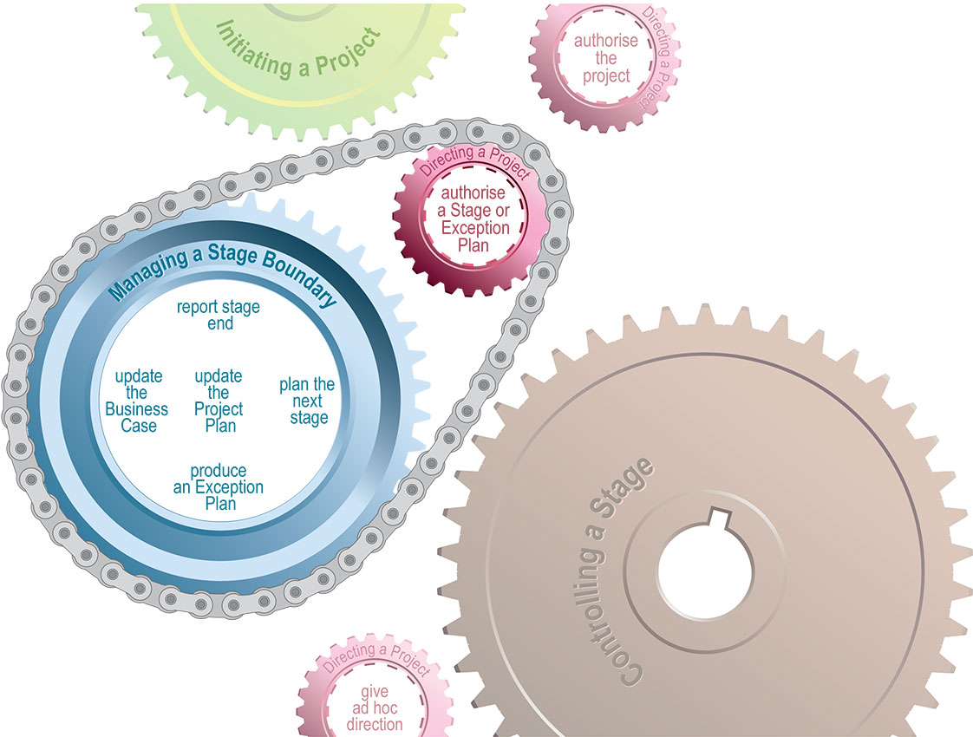
Managing a Stage Boundary
Process

Slide 4
Managing a Stage Boundary
Introduction
Stage and project exceptions are planned
Major deliverables are:
  End Stage Report
  Stage Plan or Exception Plan
Opportunity to correct a Project
The Project Board may:
  Terminate the project
  Request the Project Manager to re-plan the work
  Approve the stage to continue.

Slide 5
Managing a Stage Boundary
Objectives
Stage or Exception plan is prepared for next stage
Review & update the Project Initiation Documentation
Report all necessary information
Must ensure lessons are recorded

Slide 6
Managing a Stage Boundary
Activities
Plan the next stage
  Prior to completing the current stage the next stage is planned
  Use PID as it includes information for planning the next stage
  Involve stakeholders, update plan, modify roles, create product based planning documentation, schedule quality activities.
Produce an Exception Plan
  An Exception Plan is requested if tolerances are threatened
  Do same work as plan the next stage (activity above)

Slide 7
Managing a Stage Boundary
Activities
Update the Project Plan
  Used by Project Board to measure progress
  Updated to reflect costs and times in the Stage or Exception Plan
  Should reflect actual reported costs and times.
Update the Business Case
  External influences: competitors, other projects, legislations etc
  Internal influences: risk tolerances, Project Plan, issues etc
Report stage end
  Evaluates the stage to meet Business Case and Project Plan
  Phased handover requires confirmation of acceptance.

Slide 8
Managing a Stage Boundary
Principles
Continued business justification
Learn from experience
Defined roles and responsibilities
Manage by stages
Manage by exception
Focus on products
Tailor to suit project environment

